Slide 1

CLOUD VIRTUAL INTERNSHIP
Internship Presentation
Student Name
Internship Details
Rahul Soni
IILM UNIVERSITY
Greater Noida, U.P.
Duration: 8 Weeks Period: April–June 2026 Curriculum: AWS Academy Academic Year: 2026–27
Roll Number
2410030962
Program & Semester
B.Tech CSE • 5th Semester
Organization
EduSkills Foundation
IILM University • Cloud Virtual Internship • Rahul Soni 01

Slide 2
Internship Overview
01
What was the internship?
Learning progression
An eight-week virtual learning programme focused on cloud computing and Amazon Web Services (AWS), completed through EduSkills Foundation during April–June 2026.
The curriculum moved from cloud fundamentals to AWS architecture, security, monitoring, scalability, high availability and certification-oriented preparation.
Cloud Foundations
Cloud Architecting
Documented scope
Weeks 1–4 Cloud concepts • AWS basics • networking • compute • storage • databases • monitoring
Weeks 5–8 IAM • KMS • S3 • EC2 • RDS • VPC • Route 53 • SQS • Lambda
The supplied report describes academic learning and assessment; it does not claim deployment on a production system.
IILM University • Cloud Virtual Internship • Rahul Soni 02

Slide 3
Project Objectives & Scope
02
• Understand the fundamentals of cloud computing and AWS.
• Build foundational knowledge of cloud networking and content delivery.
• Understand compute, storage and database services in cloud environments.
• Study cloud architecture, automatic scaling and monitoring.
• Learn AWS security, high availability, decoupled and serverless concepts.
Scope: Core Services
IAM, KMS, S3, EC2, RDS, VPC, VPC Peering and Route 53.
Scope: Modern Architecture
Elasticity, automatic scaling, monitoring, SQS, Lambda and high availability.
Scope: Advanced Topics
Data engineering patterns, disaster recovery planning and AWS Solutions Architect certification preparation.
IILM University • Cloud Virtual Internship • Rahul Soni 03

Slide 4
Organization & Curriculum
03
EduSkills Foundation
AWS Academy
The supplied internship certificate confirms the eight-week Cloud Virtual Internship and identifies EduSkills Foundation as the organization through which the programme was provided.
The supplied certificate identifies AWS Academy as the curriculum provider for the cloud-focused learning programme.
01
02
03
04
05
Cloud Fundamentals
Networking & Content Delivery
Compute, Storage & Databases
Architecture, Scaling & Monitoring
Security, Availability & DR
IILM University • Cloud Virtual Internship • Rahul Soni 04

Slide 5
Technologies & AWS Services Studied
04
Security & Identity
Storage
Compute
Database
IAM • KMS
Amazon S3
Amazon EC2
Amazon RDS
Networking
DNS & Availability
Decoupling
Serverless
Amazon VPC • VPC Peering
Amazon Route 53
Amazon SQS
AWS Lambda
Operational Concepts
Monitoring • Automatic scaling • Elasticity • High availability • Disaster recovery
Learning Integration
AWS services were studied as interconnected building blocks of cloud architecture.
IILM University • Cloud Virtual Internship • Rahul Soni 05

Slide 6
Conceptual AWS Cloud Architecture
05
Users / Applications
Route 53 / Networking
Conceptual view
This architecture connects the major AWS topics studied during the internship. It is not presented as a record of a specific production system.
VPC & Network Connectivity
EC2 Compute ↔ AWS Lambda
S3 Storage ↔ RDS Database
Amazon SQS / Decoupling
IAM + KMS / Security
Monitoring + Automatic Scaling
High Availability / Disaster Recovery
IILM University • Cloud Virtual Internship • Rahul Soni 06

Slide 7
Week-wise Methodology
06
Week
Module
Focus / Learning
1
Cloud Foundations
Cloud concepts, economics & billing, AWS global infrastructure
2
Cloud Foundations
Security, networking & content delivery
3
Cloud Foundations
Compute, storage, databases & architecture fundamentals
4
Cloud Foundations
Automatic scaling & monitoring
5
Cloud Architecting
IAM, S3, EC2, RDS, VPC & VPC peering
6
Cloud Architecting
KMS, monitoring, elasticity, high availability & Route 53
7
Cloud Architecting
SQS-based decoupling & serverless microservices with Lambda
8
Cloud Architecting
Data engineering, disaster recovery & certification preparation
IILM University • Cloud Virtual Internship • Rahul Soni 07

Slide 8
Learning Outcomes
07
Cloud Fundamentals
AWS Services
Security
Scalability
Explain core cloud computing and AWS concepts.
Relate networking, compute, storage and database services.
Understand IAM, KMS and secure access concepts.
Understand monitoring, automatic scaling and elasticity.
Architecture
Modern Patterns
Resilience
Career Readiness
Connect AWS services into broader cloud architecture.
Recognize decoupled and serverless approaches.
Understand high availability and disaster recovery planning.
Build a foundation for continued AWS learning and certification preparation.
IILM University • Cloud Virtual Internship • Rahul Soni 08

Slide 9
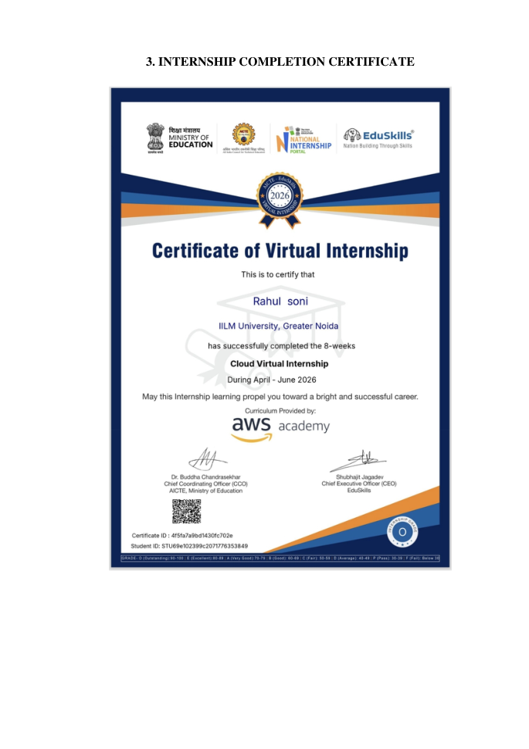
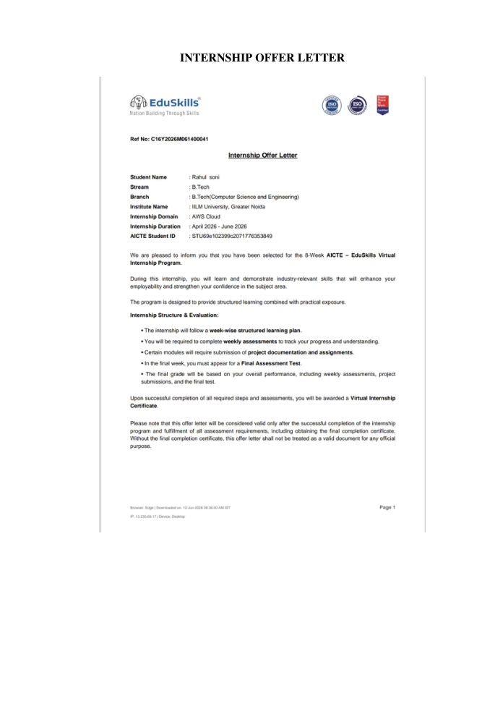
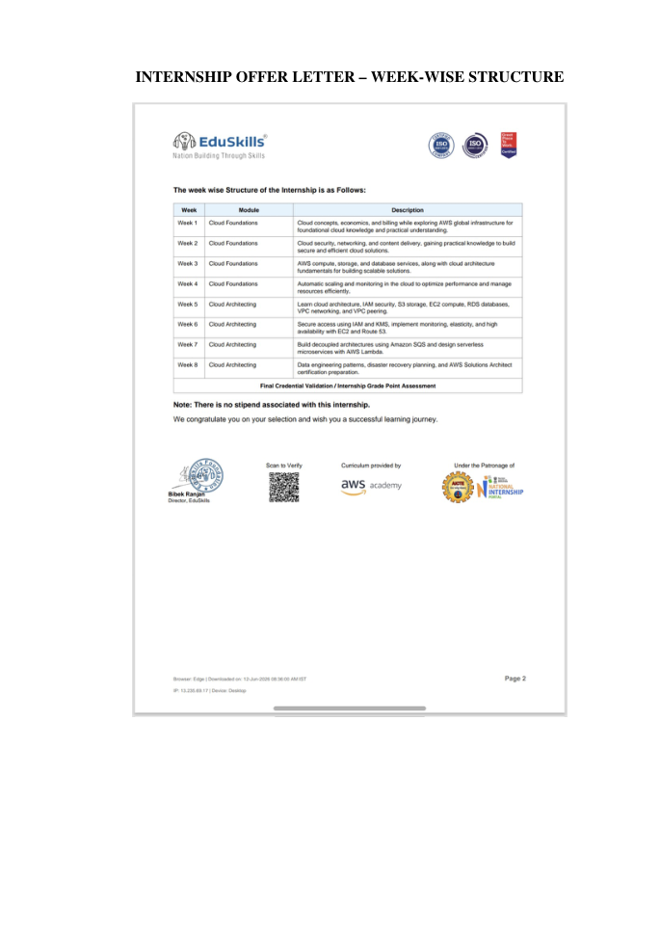
Certificates & Documentary Proof
08
Internship Completion Certificate
Internship Offer Letter
Week-wise Structure / Proof
IILM University • Cloud Virtual Internship • Rahul Soni 09

Slide 10
Conclusion & References
09
Conclusion
References
The Cloud Virtual Internship provided a structured foundation in AWS and cloud architecture. The learning progressed from fundamentals to security, scalability, availability, decoupling, serverless concepts and certification preparation.
• EduSkills Foundation — AICTE–EduSkills Virtual Internship Program – AWS Cloud, 2026.
• EduSkills Foundation — Certificate of Virtual Internship – Cloud Virtual Internship, 2026.
• AWS Academy — AWS Cloud curriculum referenced in the supplied internship materials.
• EduSkills Foundation — Official Website: eduskillsfoundation.org
• IILM University, School of Computer Science & Engineering — Internship Report Format, 2026–27.
Overall Takeaway
The internship helped connect individual AWS services with broader requirements of cloud architecture and operational management.
IILM University • Cloud Virtual Internship • Rahul Soni 10

Slide 11
THANK YOU
Cloud Virtual Internship
Rahul Soni • B.Tech CSE • IILM University
EduSkills Foundation | April–June 2026
IILM University • Cloud Virtual Internship • Rahul Soni 11

